Slide 1
ProJect “Măsurări și traductoare”
Automatic Door

Slide 2
The goal of the project
The goal of the project is to create an automatic system that operates a door using a light sensor.

Slide 3
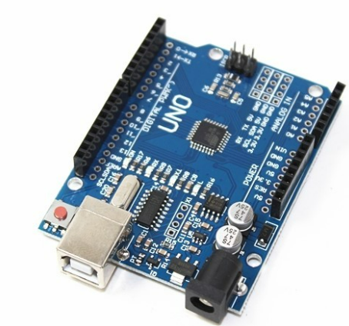
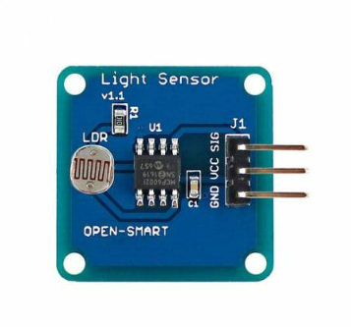
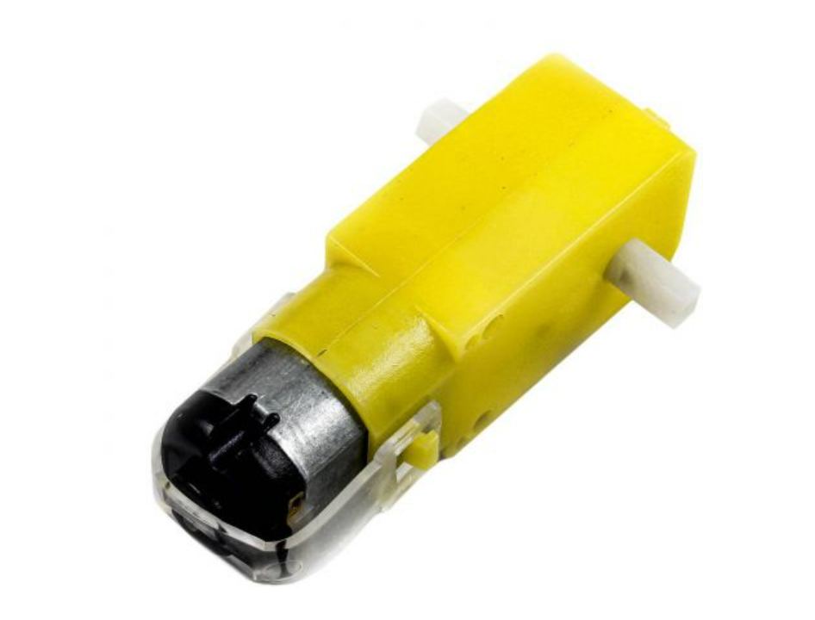
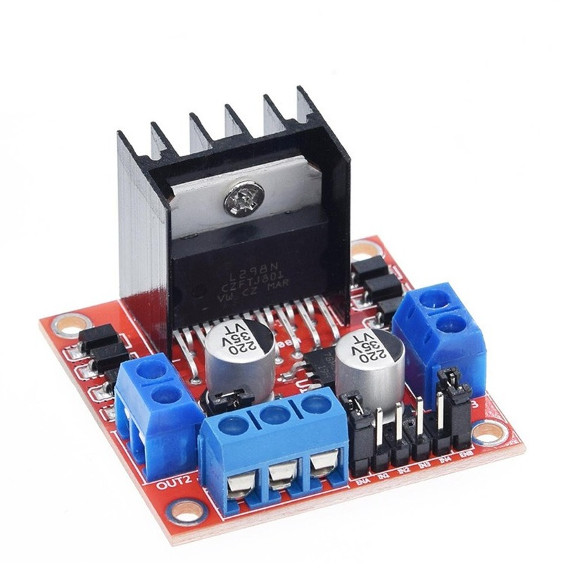
Components used
Arduino
Light sensor
electric motor
Driver Motor

Slide 4
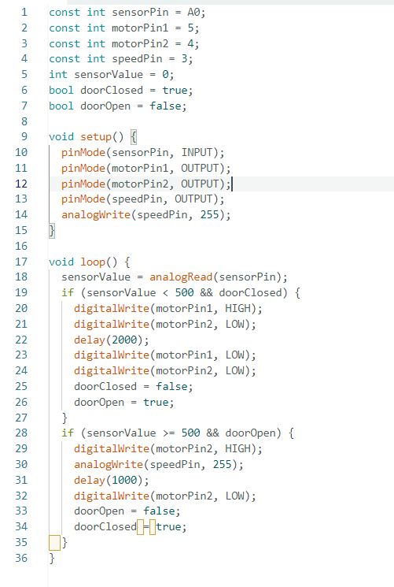
Codul
This code configures the input and output pins. Then, it reads the analog values from the sensor, and based on this value, it activates the motor to raise or lower the gate.

Slide 5
Several images showcasing the prototype testing.

Slide 6
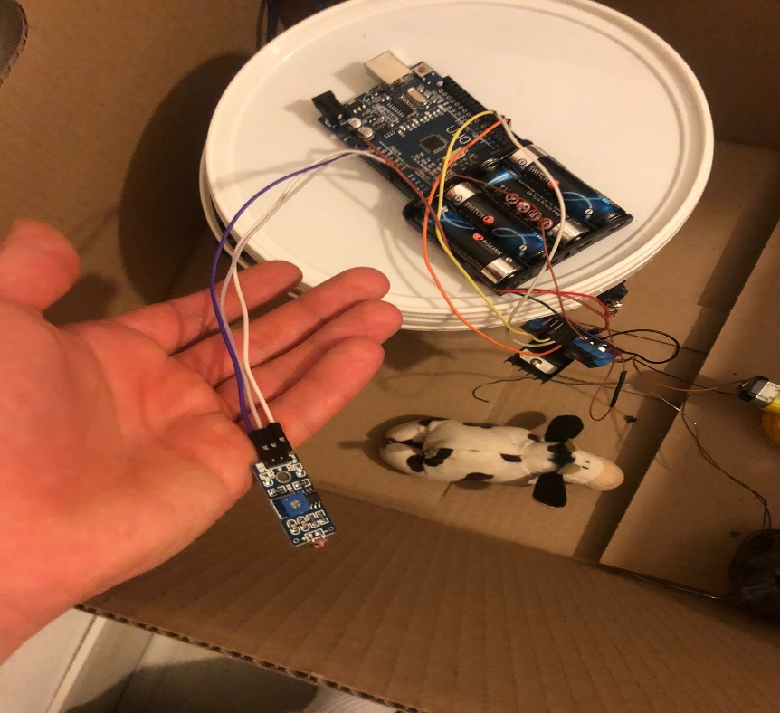
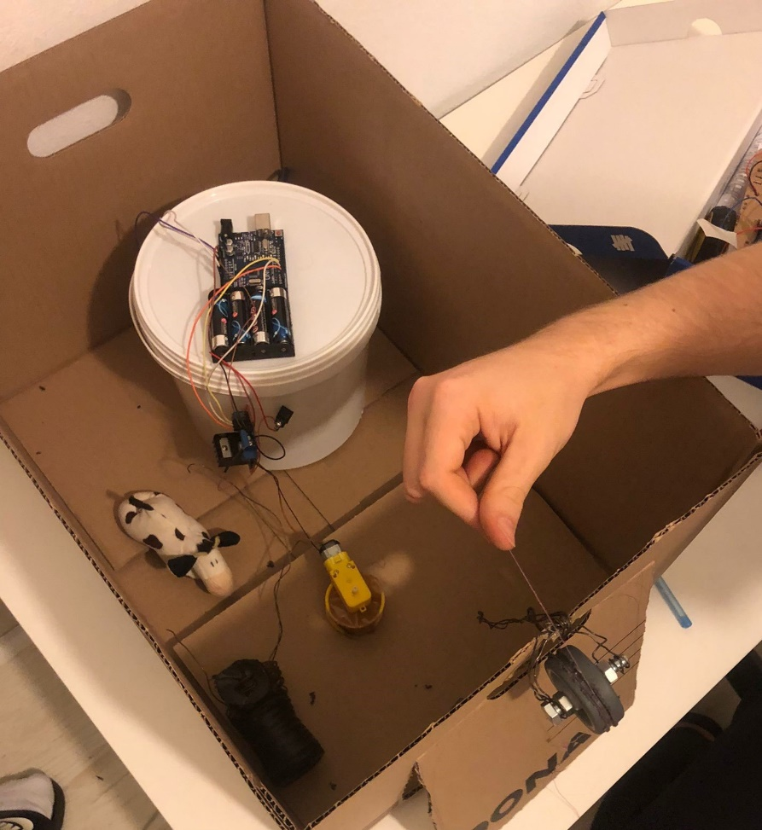
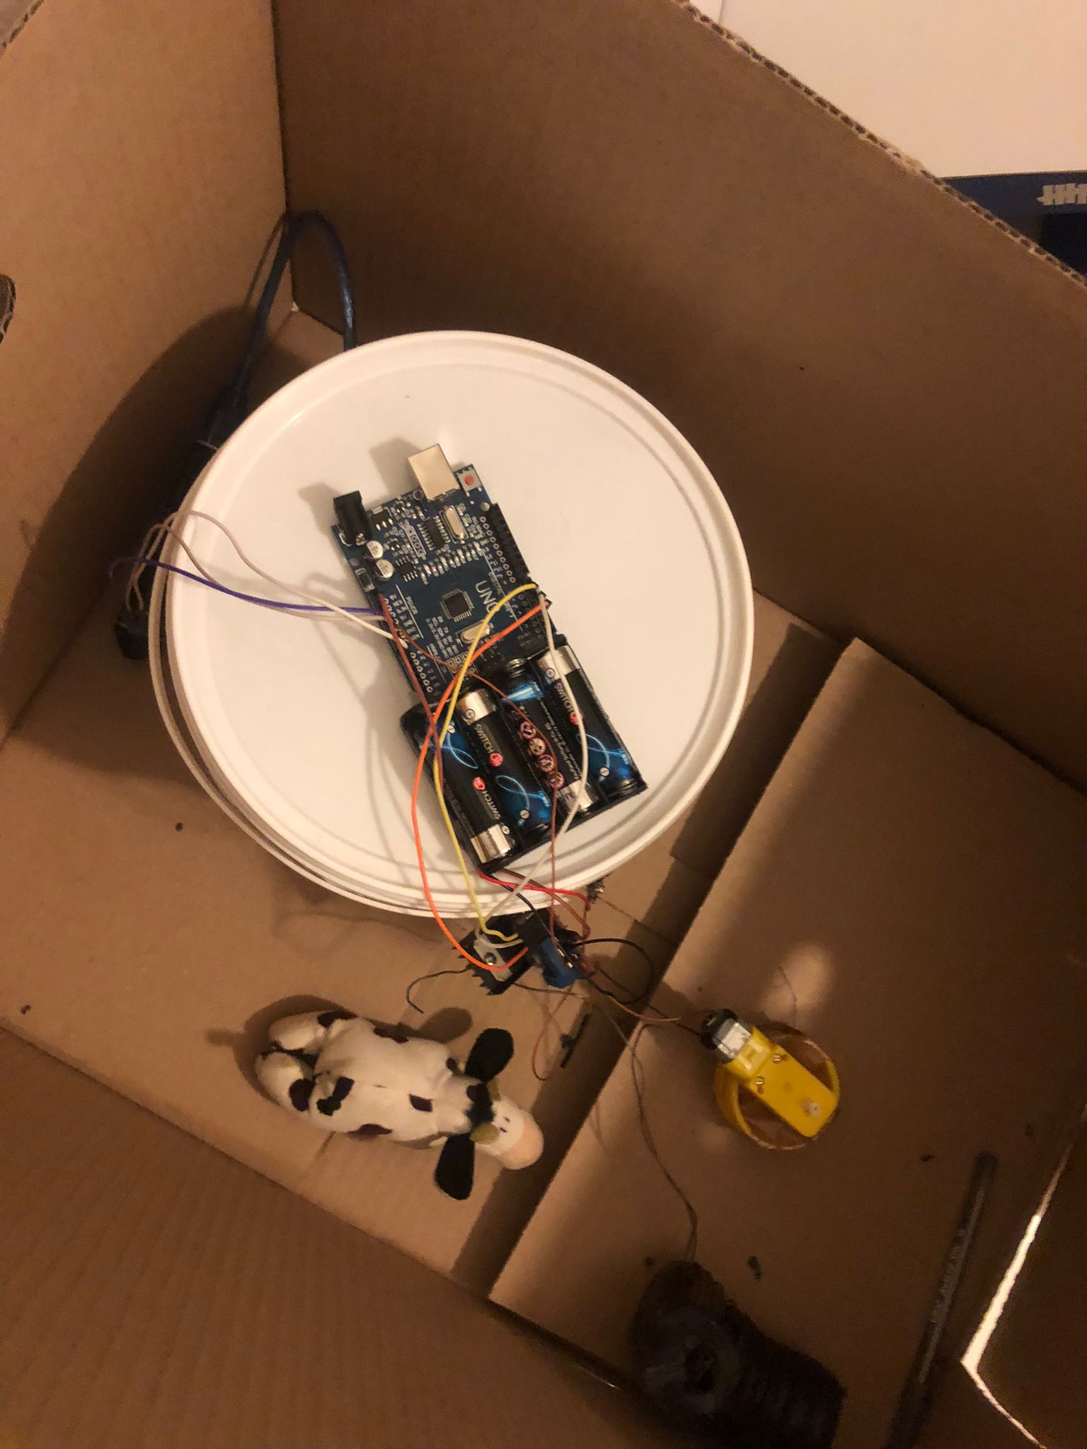
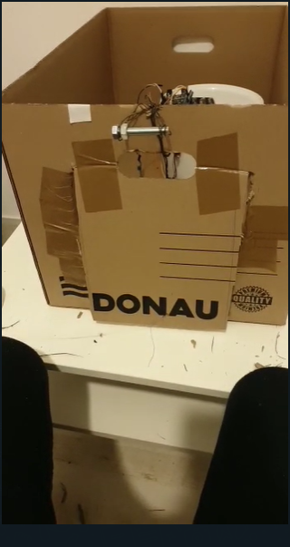
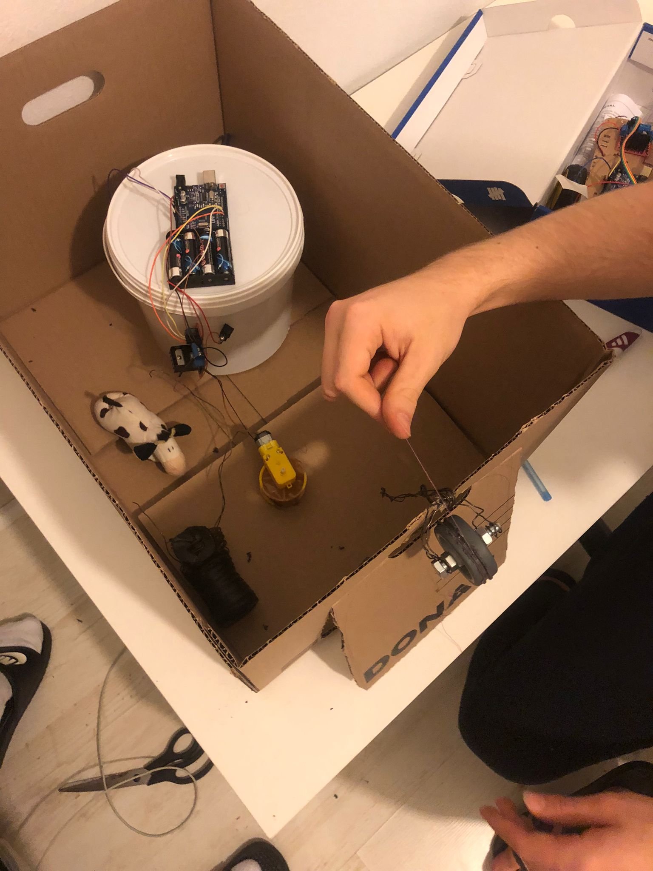

Slide 7
The utility of the project
The project can be used as an automatic door for various backyard birds (chickens, ducks, geese), where the door opens when the sun rises, allowing the birds to go outside during the day. At night, the door remains closed, protecting them from predators.
The system can also be used in the same manner for pets (cats, dogs) for people living in houses.

Slide 8
Thank you for your atention
Avasîloaie Ștefan
Diumea Gabriele

